Slide 1

Maven Market Data Analysis
Unlocking Retail Growth & Profitability
Strategic Insights for Business Decision-Makers

Slide 2
Project Overview: Driving Retail Success
This project leverages comprehensive sales, customer, and store data to uncover actionable insights. Our goal is to empower strategic decisions across marketing, product development, and store expansion, ensuring sustainable growth and enhanced profitability for Maven Market.
01
02
Define Aim & Questions
Data Preparation
Clarifying objectives and key business inquiries.
Cleaning, modeling, and structuring raw data for analysis.
03
04
Analysis & Visualization
Insights & Recommendations
Extracting patterns and presenting them visually.
Translating findings into strategic business actions.

Slide 3
Addressing Key Business Questions
Our analysis focuses on critical areas to optimize Maven Market's operations and strategy. Understanding these facets is crucial for informed decision-making.
Product Profitability
Customer Segmentation
Return Impact
Identifying top-performing brands and areas for intervention.
Understanding demographics that drive sales for targeted marketing.
Assessing how returns affect profitability and product quality.
Store Performance
Revenue Trends
Locating revenue-generating stores for expansion strategies.
Analyzing temporal patterns for forecasting and seasonality.

Slide 4
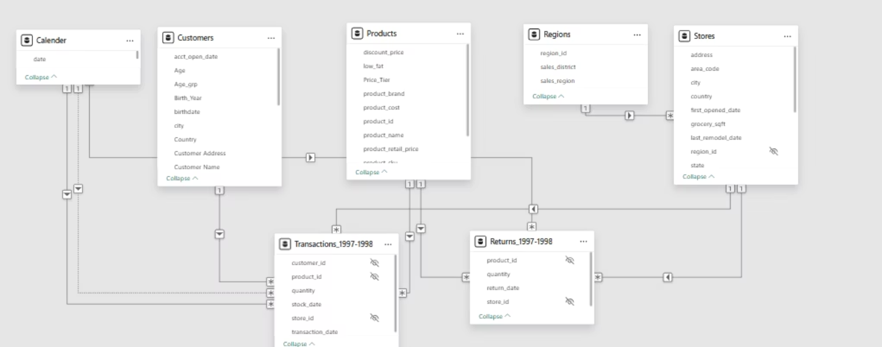
Data Foundation: Maven Market Dataset
Our analysis is built upon the comprehensive Maven Market dataset, simulating retail transactions and returns from 1997-1998. This rich dataset includes 269,720 transaction records, along with detailed tables on stores, calendar, customers, products, regions, and returns.
Data Structure
Fact Tables: Returns, Transactions (capturing key events)
Dimension Tables: Store, Calendar, Customer, Product, Region (providing descriptive context)
A star schema forms the core, with a snowflake extension for regional hierarchy.

Slide 5
Data Preparation & Modeling
Rigorous data cleaning and modeling ensured the accuracy and usability of our dataset for in-depth analysis.
Key Preprocessing Steps
Data Model Summary
Date Transformation: Extracted `start of the week` and other features for time-series analysis.
Star Schema: Utilizes 2 fact tables and 5 dimension tables for efficient querying.
Categorical Standardization: Normalized values like education levels and country names (e.g., "USA" to "US").
Snowflake Schema: A region table linked to the store table introduces hierarchical depth.
Data Type Correction: Ensured all columns were in appropriate formats (dates, numeric, categorical).
Cardinality: All relationships are 1-to-many, from dimensions feeding into fact tables.
Value Handling: Addressed inconsistent text entries, though no missing values were present in this specific dataset.

Slide 6
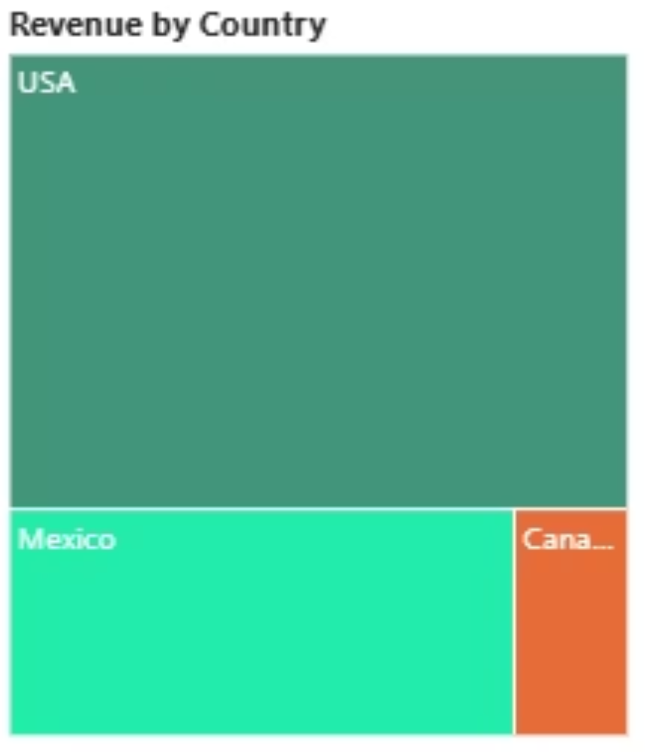
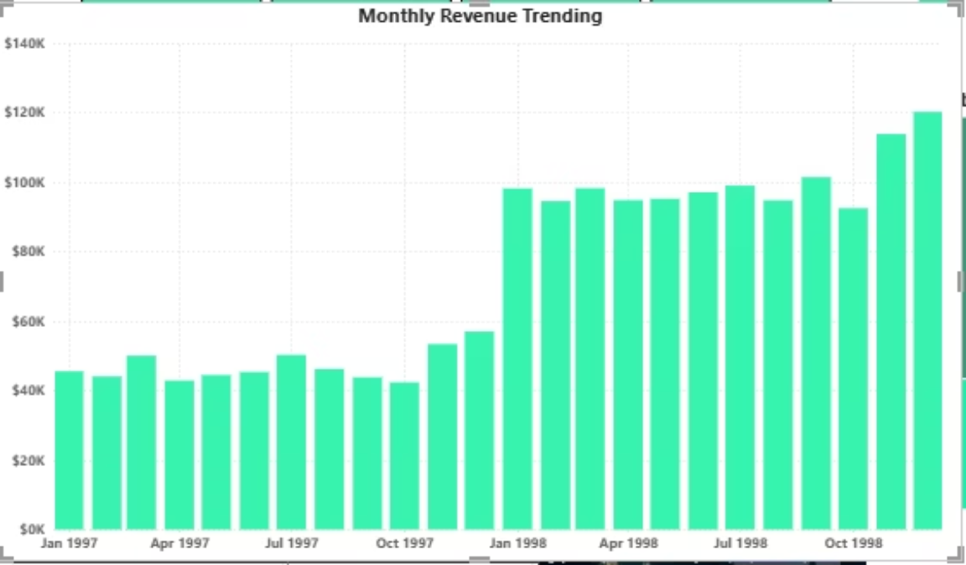
Analysis & Key Visualizations
Our analysis revealed significant trends and performance indicators across various dimensions of the business.
Monthly Revenue Trend
Revenue by Country
A clear upward trajectory, with 1998 revenue nearly doubling 1997's, highlighting strong growth.
The USA, Mexico, and Canada represent the top three revenue contributors, with the USA leading significantly.

Slide 7




Key Insights: Performance at a Glance
Our analysis highlights critical areas of success and opportunities for targeted improvement.
Strong Profitability
USA Drives Revenue
Total profit of $1.05M with a solid return rate of 0.99%, indicating healthy financial performance.
The USA is the largest source of revenue, significantly outperforming Mexico and Canada.
Significant YoY Growth
Exceeding Profit Goals
Experienced over 212% year-over-year growth, showcasing strong performance and expansion.
Current month's profit of $71,682 exceeded goal by 5.61%.

Slide 8
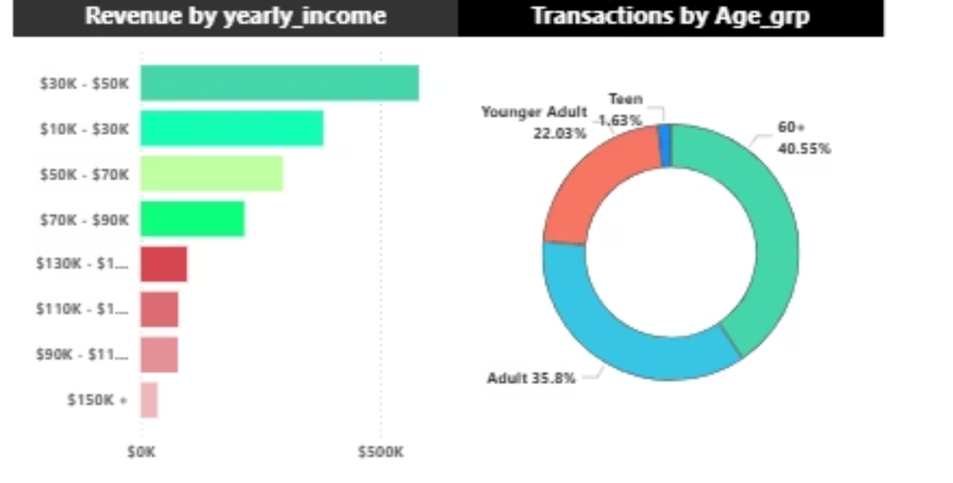
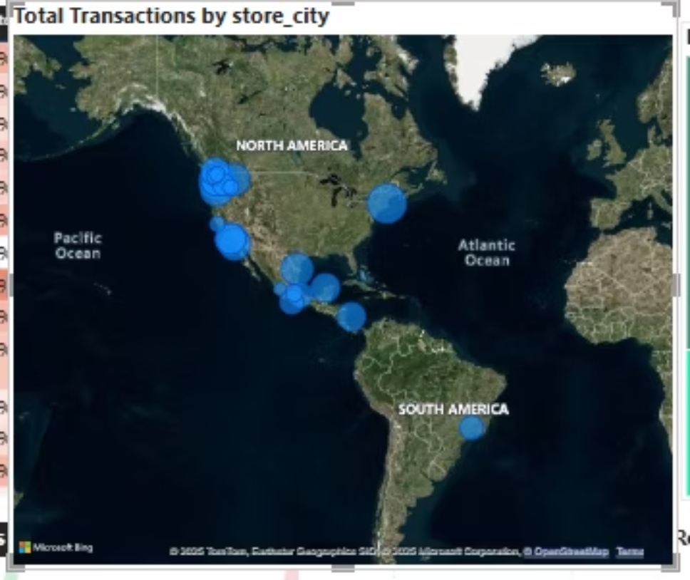
Customer & Store Dynamics
High-Income Customers Drive Revenue
Supermarkets Lead Revenue Generation
The majority of revenue originates from customers in the $30K–$50K and $10K–$30K income brackets, indicating a key demographic for Maven Market.
Supermarkets are the top revenue generators, followed closely by Deluxe Supermarkets, emphasizing their crucial role in the business model.
Adults (35.8%) and the 60+ age group (40.55%) constitute the vast majority of transactions, making them the primary drivers of business activity.
North America also holds the highest number of stores, as shown on the map, reinforcing its importance to the network.

Slide 9




Strategic Recommendations for Growth
Based on our data analysis, we propose actionable strategies to capitalize on strengths and address opportunities.
Promote "Hermanos"
Address Regional Gaps
Focus marketing, inventory, and bundle deals on the top-performing "Hermanos" brand to maximize profit.
Investigate revenue shortfalls in the USA and Canada, implementing targeted campaigns and addressing root causes.
Monitor Revenue Trends
Sustain Profit Growth
Continuously track monthly and regional revenue to detect issues early and adjust strategies proactively.
Replicate successful initiatives and focus on high-margin products across all regions to maintain momentum.

Slide 10

Unlocking Your Potential
Turning Data into Decisive Action for Maven Market
Thank you for your time.
Questions?

